Slide 1
Project 1
Dylan Stuart

Slide 2
Tables
Count
Branch
CREATE TABLE if NOT exists Count(Drink String, Drink_Count Int)
row format delimited fields terminated by ','
stored as textfile;
CREATE TABLE if NOT exists Branch(Drink String, BranchID String)
row format delimited fields terminated by ','
stored as textfile;

Slide 3
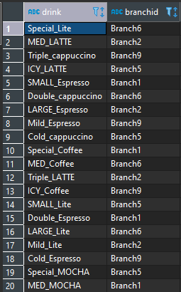
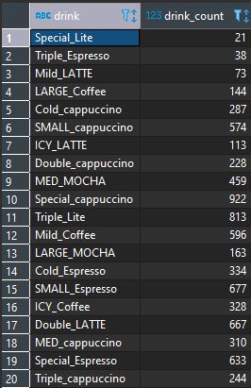
Load Data
LOAD DATA INPATH ‘/user/dylan/Count.txt’ OVERWRITE INTO TABLE Count;
LOAD DATA INPATH ‘/user/dylan/Branch.txt’ OVERWRITE INTO TABLE Branch;

Slide 4

Problem Statement 1 Q1
What is the total number of consumers for Branch1?
RESULTS
SELECT sum(C.drink_count)
FROM Branch B JOIN count C on (B.Drink = C.Drink)
WHERE b.BranchID = “Branch1”;

Slide 5

Problem Statement 1 Q2
What is the total number of consumers for Branch2?
RESULTS
SELECT sum(C.drink_count)
FROM Branch B JOIN count C on (B.Drink = C.Drink)
WHERE b.BranchID = “Branch2”;

Slide 6

Problem Statement 2 Q1
What is the most consumed beverage on Branch1?
RESULTS
SELECT C.drink, sum(C.Drink_count) as Drink_total
FROM Branch B JOIN count C on (B.Drink = C.Drink)
WHERE b.BranchID = “Branch1”
GROUP BY C.Drink
ORDER BY Drink_total DESC limit 1

Slide 7

Problem Statement 2 Q2
What is the least consumed beverage on Branch2?
RESULTS
SELECT C.drink, sum(C.Drink_count) as Drink_total
FROM Branch B JOIN count C on (B.Drink = C.Drink)
WHERE b.BranchID = “Branch2”
GROUP BY C.Drink
ORDER BY Drink_total limit 1

Slide 8
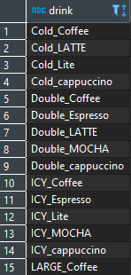
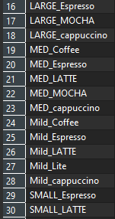
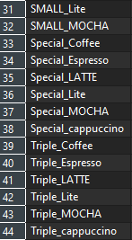
Problem Statement 3 Q1
What are the beverages available on Branch10, Branch8, and Branch1?
RESULTS
SELECT DISTINCT Drink
FROM Branch
WHERE BranchID = ‘Branch1’ OR BranchId = ‘Branch8’ OR BranchID = ‘Branch10’

Slide 9
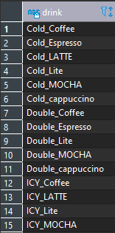
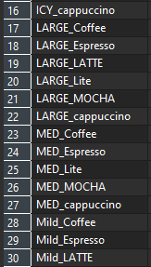
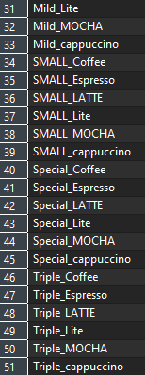
Problem Statement 3 Q2
What are the common beverages in Branch4, Branch7?
RESULTS
SELECT DISTINCT Drink
FROM Branch
WHERE BranchID = ‘Branch4’
INTERSECT
SELECT DISTINCT Drink
From Branch
Where BranchID = ‘Branch7’

Slide 10

Problem Statement 4: Views Q1
Create a partition, index, view for scenario 3
RESULTS
CREATE view if NOT exists PS_3_Q1 as
SELECT DISTINCT Drink
FROM Branch
WHERE BranchID = ‘Branch1’ OR BranchId = ‘Branch8’ OR BranchID = ‘Branch10’

Slide 11

Problem Statement 4: Views Q2
Create a partition, index, view for scenario 3
RESULTS
CREATE view if NOT exists PS_3_Q2 as
SELECT DISTINCT Drink
FROM Branch
WHERE BranchID = ‘Branch4’
INTERSECT
SELECT DISTINCT Drink
From Branch
Where BranchID = ‘Branch7’

Slide 12
Problem Statement 4: Index
Create a partition, index, view for scenario 3
RESULTS
CREATE index INDEX_PS4 ON table Branch(Drink) as ‘COMPACT’ WITH DEFERRED REBUILD
ALTER index INDEX_PS4 on Branch REBUILD

Slide 13
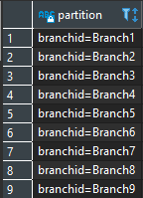
Problem Statement 4: Partition
Create a partition, index, view for scenario 3
RESULTS
CREATE TABLE Branch_Partition(Drink String) PARTITIONED BY (BranchID String)row format delimited fields terminated by ',' stored as textfile;
INSERT OVERWRITE TABLE branch_partition PARTITION (branchid) select Drink, BranchID from branch;

Slide 14
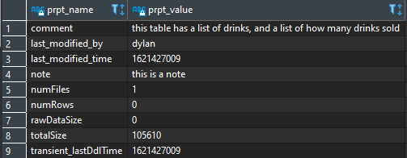
Problem Statement 5
Alter the table properties to add ‘notes’ , ‘comments’
RESULTS
ALTER TABLE count
SET TBLPROPERTIES('comment'='this table has a list of drinks, and a list of how many drinks sold');
ALTER TABLE count
SET TBLPROPERTIES('note'='this is a note');

Slide 15
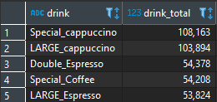
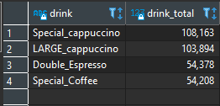
Problem Statement 6
Remove row 5 from the output of an table
BEFORE
AFTER
SELECT drink, drink_total
FROM (select pbs6.*, ROW_NUMBER() over (order by drink_total DESC) as rownum from pbs6) pbs6
WHERE rownum != 5;

Slide 16
THANK YOU!

